Slide 1



Malaria Deaths in Africa: 2000-2014

Slide 2

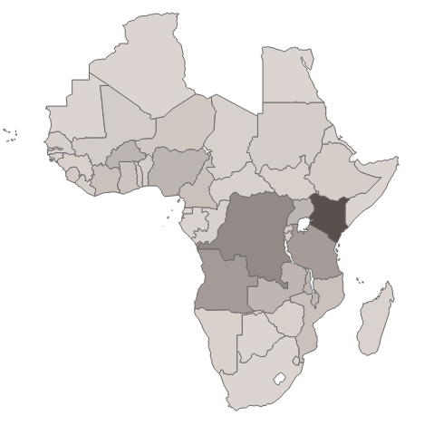
AFRICA
This dataset describes the deaths due to malaria in Africa during the period 2000-2014 with Kenya being the country with the most number of deaths and Algeria with the least. Malaria was an epidemic in Africa in this time-period

Slide 3

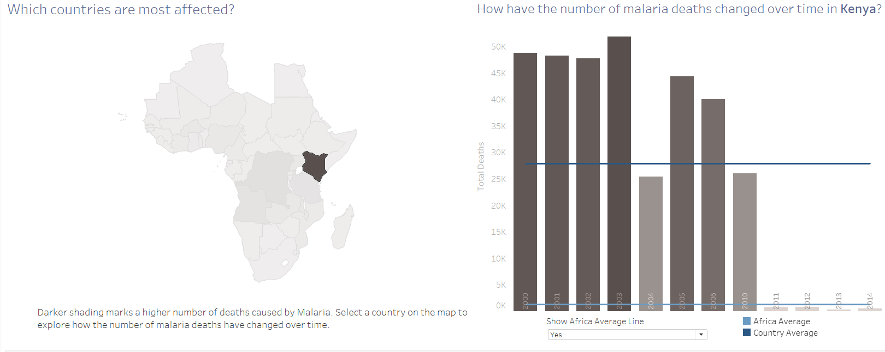
Kenya
Kenya has an average of 27,896 deaths per year with an average of 76 deaths everyday. It is the country with most number of deaths with maximum number of deaths in 2003 and though the conditions improved going towards 2011with the least number of deaths in 2013

Slide 4

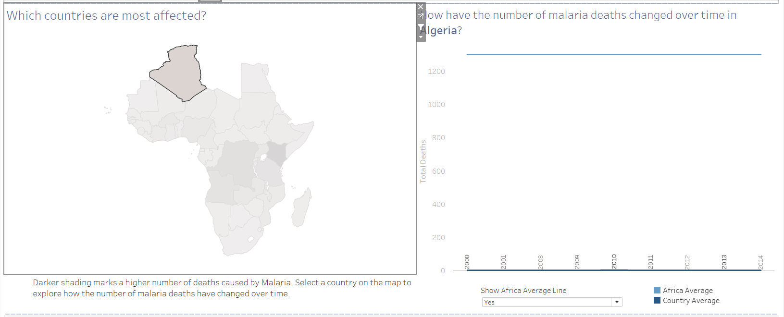
Algeria
The biggest country of Africa, with the least number of deaths due to malaria Algeria has an average of 1 death due to malaria in Africa . It has been stagnant in the matter of deaths due to malaria throughout

Slide 5

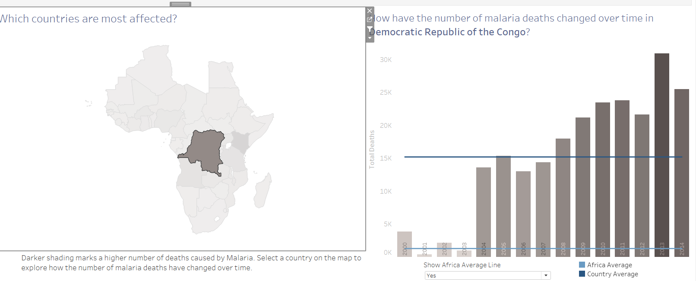
Democratic Republic of Congo
With an average annual death rate of 15203 and per day death rate of 41-42 people Congo shows slightly different trends than other countries as they witnessed a decrease in death rate due to malaria Congo showed a significant rise over the years as the time passed with the maximum deaths in the year 2013

